Slide 1



Slide 2



 | Slope Bins 4 | Smear Count 25
Block number | Alpha w/ Henderson Hasselbalch | Chi Chi_max = 2.2
[0 50] | 0.040012 | 1.160000
[50 75] | -0.278451 | 0.720000
[75 125] | -0.519707 | 0.608000
[125 156] | -0.154453 | 0.529032

Slide 3


 | Slope Bins 4 | Smear Count 31
Block number | Alpha w/ Henderson Hasselbalch | Chi Chi_max = 2.2
[0 31] | 0.001103 | 0.922581
[31 62] | -0.386873 | 0.703226
[62 93] | -0.290146 | 0.967742
[93 496] | 0.037164 | 1.098759
[496 527] | -0.064533 | 0.819355
[527 620] | 0.010682 | 0.756989
[620 647] | -0.103326 | 0.696296

Slide 4
Approach
B, and v will be different for L and H
Chi should be same
Match pure L and H first, then mix
SCFT Purpose:
Additional information of underlying protein organization
Possible underlying conformational change driven by Cs

Slide 5
Summary

Slide 6
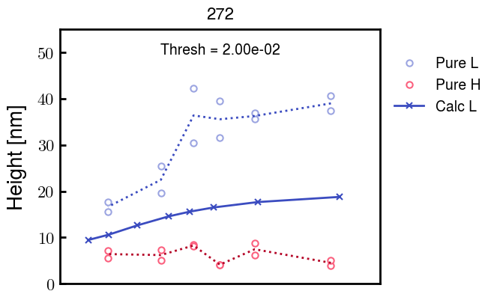
b2.0 v2.7 c3.2
b3.0 v7.0 c3.5

Slide 7
NFH fitting (from NFL best fit)

Slide 8








b1.00, v0.50, c3.2
b2.00, v4.00, c3.2, th2.5e-02
b1.00, v2.00, c3.2
b1.00, v1.00, c3.2

Slide 9
Mixture

Slide 10



Slide 11


b = 0.75

Slide 12





Slide 13
b = 1.0

Slide 14





Slide 15
b = 1.25

Slide 16




Chi 2.6
Bad vol frac

Slide 17








b25v0
b25v1
b25v2
b25v3

Slide 18




Chi 2.8
Bad vol frac

Slide 19





Slide 20
b = 1.50

Slide 21






Chi 2.8
Bad vol frac

Slide 22





Slide 23

b = 2.00
v4 = 0.25*b^3

Slide 24


Bad vol frac

Slide 25



Slide 26
Fine tune

Slide 27



b1.25, v1.95, c3.0
b1.50, v3.38, c3.0
b2.00, v4.00, c3.0
Norm seems to capture kinked behavior

Slide 28




Slide 29



b1.25, v1.95, c3.2
b1.50, v3.38, c3.2
b2.00, v4.00, c3.2

Slide 30




Slide 31




b1.25
b1.50
b2.00
c2.8
c3.0
c3.2

Slide 32


b2.00 v2.70 c3.20
b2.00 v2.75 c3.20

